Slide 1
Chapter 1: Introduction to the Study of Memory

Slide 2
The Science of Memory (1 of 4)
Science: Particular view of the world.
  Scientific viewpoint?
Science should be unbiased!
How to test?
Notes:
Satisfies Learning Objective 1: Explain the nature and importance of memory.
Science: Refers to a particular view of the world, one based on systematic observation, experimentation, and theory.
Unbiased attitude critical to science: In science, a particular theory is useful only if careful and unbiased observations and experimentation support it.
Test via scientific method: Our intuitions and guesses about the world must be tested and verified via the scientific method.
Empirical evidence: The product of scientific research. To be empirical evidence, data must be verifiable.
In memory science, empirical evidence is the results of experiments, which can and should be replicable.

Slide 3
The Science of Memory (2 of 4)
Observe/
Question
Hypothesis
Experiment/
Test Hypothesis
Analyze Results
Form Conclusions
Notes:
Satisfies Learning Objective 1: Explain the nature and importance of memory.
Science: Refers to a particular view of the world, one based on systematic observation, experimentation, and theory.
Unbiased attitude critical to science: In science, a particular theory is useful only if careful and unbiased observations and experimentation support it.
Test via scientific method: Our intuitions and guesses about the world must be tested and verified via the scientific method.
Empirical evidence: The product of scientific research. To be empirical evidence, data must be verifiable.
In memory science, empirical evidence is the results of experiments, which can and should be replicable.

Slide 4
The Science of Memory (3 of 4)
Empirical evidence:
  The produce of scientific research
What does it mean to be empirical?
    Data must be verifiable
    Data should be replicable
  Empirical evidence from Experiments == Basis of human memory research
Notes:
Satisfies Learning Objective 1: Explain the nature and importance of memory.
Science: Refers to a particular view of the world, one based on systematic observation, experimentation, and theory.
Unbiased attitude critical to science: In science, a particular theory is useful only if careful and unbiased observations and experimentation support it.
Test via scientific method: Our intuitions and guesses about the world must be tested and verified via the scientific method.
Empirical evidence: The product of scientific research. To be empirical evidence, data must be verifiable.
In memory science, empirical evidence is the results of experiments, which can and should be replicable.

Slide 5
The Science of Memory (4 of 4)
Goal of memory science:
  Make generalizations about how memory works in the real world
  Perform careful experimentation to produce empirical evidence
  Use evidence to make cause/effect connections between variables.
Field studies on memories in real world:
  Validity/Control trade off
Notes:
Satisfies Learning Objective 1: Explain the nature and importance of memory.
Difference: Empirical data contrast with stories and anecdotes.
Experiments and empirical evidence form the basis of what we know about human memory from a scientific perspective.
Goal of memory science:
To make generalizations about how memory works in the real world by studying it under careful and controlled laboratory conditions.
The control involved allows for careful experimentation, which produces valuable empirical evidence and allows us to make causal connections between variables.
Field studies on memories in real world: Memory researchers are occasionally able to conduct field studies in which they study memory in the real world, including memories for crimes to confirm laboratory research.

Slide 6
The History of Memory Research
(1 of 8)
Ancient Greeks
  Plato used metaphors to describe memory
    Wax Tablet
    Birdcage
Locke, Berkeley, Ebbinghaus: How mind associates ideas.
Notes:
Satisfies Learning Objective 2: Describe the history of memory research.
Memories of hunting stories reenacted by Stone Age art: It is likely, though unproven that Stone Age art reenacts memories of great hunting stories.
Writings about memory:
An ancient Egyptian medical manual, the Ebers Papyrus, from 1550 BCE describes the nature of memory deficits after injury.
Plato and Aristotle described theories of memory that sound surprisingly modern.
Surely, many philosophers and medical professionals have written about the nature of memory during the ensuing millennia, which have been lost to history.
Memory metaphors:
These are verbal models of how memory works.
Plato (428–347 BCE) used two metaphors to account for memory:
First, he compared human memory to a wax tablet.
As learning occurs, information gets written into memory.
Although outdated, this metaphor allows memory to be encoded, retrieved, and altered if the wax gets altered.
Second, Plato compared human memory retrieval to a birdcage.
Sometimes, the memory may be difficult to retrieve, just as the bird may be difficult to catch.
The author has compared memory to a teenager’s room.
It may appear disorganized, but the teenager knows where to find things because of his or her unique organizational schema.
Locke, Berkeley:
John Locke and George Berkeley emphasized how the mind creates associations between one idea and another.
It was applied to the study of memory when German psychologist Hermann Ebbinghaus published a volume titled Memory: A Contribution to Experimental Psychology.

Slide 7
The History of Memory Research
(2 of 8)
Hermann Ebbinghaus (1850–1909)
First to use scientific methods.
Used only one test participant, himself.
Experiment on nonsense syllables.
Notes:
Satisfies Learning Objective 2: Describe the history of memory research.
Hermann Ebbinghaus published a volume titled Memory: A Contribution to Experimental Psychology.
Ebbinghaus was the first person to use scientific methods to study memory and to use the experimental method to address issues of higher cognition:
He established many principles of memory that are still relevant today.
A number of his findings are directly applicable to the goals of improving memory efficiency.
Ebbinghaus taught himself lists of nonsense syllables, meaningless syllables that can be given to participants to study that avoid the effect of meaning on memory (e.g., wob).
Ebbinghaus prepared lists of 6–20 nonsense syllables and studied each until he could free-recall all of the nonsense syllables in it.
Later, he tested himself to see how many syllables he could remember from each list.
He found it was easier to master the shorter lists than the longer ones.
Conclusion for memory in general: Shorter lists are easy to master than longer lists.

Slide 8
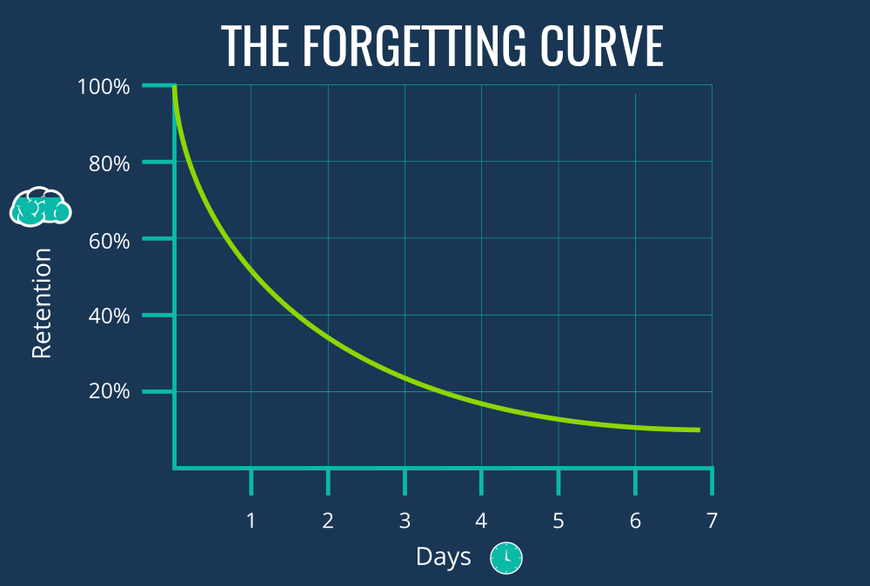
Notes:
Satisfies Learning Objective 2: Describe the history of memory research.
Experient on varying retention interval:
He experimented on varying the retention interval (the amount of time that transpires between the learning of an event or material and when recall for that event or material occurs) between when he studied a list and when he retrieved that list.
Conclusion: The longer the amount of time between learning and remembering, the more will be forgotten.
Measurement of forgetting by looking at savings score, the reduction in time required to relearn a previously mastered list.
Conclusion: Although savings diminished with longer retention interval, no matter how long the retention interval was, there was always some evidence of savings.
Bahrick showed that there are savings in American participants’ memory for high school second-language Spanish and French vocabulary even 25 years after the last time a student took those courses.
It allowed Ebbinghaus to examine some other characteristics of memory as well.
Forgetting curve: A graph that traces the decline of memory performance over time.
Ebbinghaus noticed that forgetting happened rapidly at first.
Testing himself a month later for a particular list would still reveal some memory for that list.
Some variables affect the forgetting curve, making forgetting occur more rapidly, while others like overlearning preventing rapid forgetting.

Slide 9
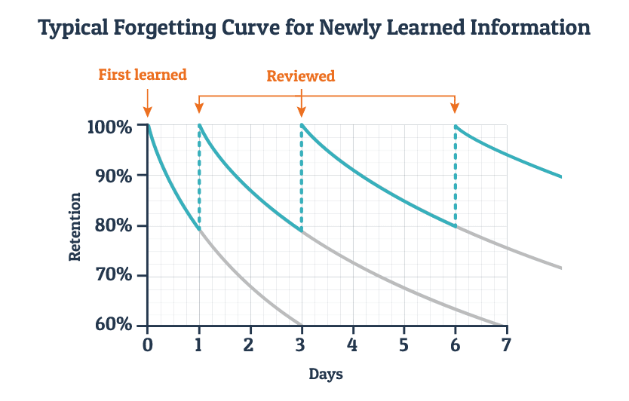
Notes:
Overlearning: Studying after material has been thoroughly learned.
Ebbinghaus found that if he overlearned a list, his forgetting curve was less steep.
Conclusion: Studying past the point of mastery led to better long-term retention of that information.
Ebbinghaus studied the distribution of study time:
He studied some lists, all at once. (Massed practice: When all study occurs in one block of time.)
For other lists, he distributed his study over a series of lists and a series of days. (Distributed practice: When study is spread out over time.)
Conclusion:
Spacing effect: More learning occurs when study trials on the same information are spread out over time than when they occur successively.
It also took less total time to master a list that had been given distributed practice than one that received massed practice.
Modern studies show that distributed practice can produce enormous boosts in the amount remembered per amount of time studied relative to massed practice.

Slide 10
The History of Memory Research
(3 of 8)
Mary Calkins (1863–1930)
Examination of paired-associate learning.
Example: Cat – Dog
Notes:
Satisfies Learning Objective 2: Describe the history of memory research.
Paired-associate learning: Learning the association between two items, such as in language learning (e.g., learning the association monkey–le singe).
Calkins had her participants study cue-target pairs of various types. She would present the first word in a word–word pair and the participant would have to respond with the target, the second word from the pair.
She discovered that the greater the overlap between meaning in cue-target pairs, the easier it was for the participant to learn and retain the information. Prior familiarity with the cue-target pairs also helped learning.
In her investigations of short-term memory, Calkins discovered the recency effect, the observation that memory is usually superior for items at the end of a list; thought to be caused by the maintenance of those items in working memory.
Career:
Throughout her career, Calkins campaigned for equality for woman, especially in academia.
She became the first woman president of the American Psychological Association and then the president of the American Philosophical Association.

Slide 11
Paired Associates
Muffin – Vase
Light – Mouse
Stand – Blanket
Clock – Book
Lamp – Cheese
Elbow – Trash
Cloth – Budge
Phone – Write
Plan - Shelf
Notes:
Satisfies Learning Objective 2: Describe the history of memory research.
Paired-associate learning: Learning the association between two items, such as in language learning (e.g., learning the association monkey–le singe).
Calkins had her participants study cue-target pairs of various types. She would present the first word in a word–word pair and the participant would have to respond with the target, the second word from the pair.
She discovered that the greater the overlap between meaning in cue-target pairs, the easier it was for the participant to learn and retain the information. Prior familiarity with the cue-target pairs also helped learning.
In her investigations of short-term memory, Calkins discovered the recency effect, the observation that memory is usually superior for items at the end of a list; thought to be caused by the maintenance of those items in working memory.
Career:
Throughout her career, Calkins campaigned for equality for woman, especially in academia.
She became the first woman president of the American Psychological Association and then the president of the American Philosophical Association.

Slide 12
Paired Associates
Muffin – ?
Light – ?
Stand – ?
Clock – ?
Lamp – ?
Elbow – ?
Cloth – ?
Phone – ?
Plan - ?
Notes:
Satisfies Learning Objective 2: Describe the history of memory research.
Paired-associate learning: Learning the association between two items, such as in language learning (e.g., learning the association monkey–le singe).
Calkins had her participants study cue-target pairs of various types. She would present the first word in a word–word pair and the participant would have to respond with the target, the second word from the pair.
She discovered that the greater the overlap between meaning in cue-target pairs, the easier it was for the participant to learn and retain the information. Prior familiarity with the cue-target pairs also helped learning.
In her investigations of short-term memory, Calkins discovered the recency effect, the observation that memory is usually superior for items at the end of a list; thought to be caused by the maintenance of those items in working memory.
Career:
Throughout her career, Calkins campaigned for equality for woman, especially in academia.
She became the first woman president of the American Psychological Association and then the president of the American Philosophical Association.

Slide 13
The History of Memory Research
(4 of 8)
Mary Calkins (1863–1930)
Examination of paired-associate learning.
Recency effect: Memory is better for items at the end of a list
Notes:
Satisfies Learning Objective 2: Describe the history of memory research.
Paired-associate learning: Learning the association between two items, such as in language learning (e.g., learning the association monkey–le singe).
Calkins had her participants study cue-target pairs of various types. She would present the first word in a word–word pair and the participant would have to respond with the target, the second word from the pair.
She discovered that the greater the overlap between meaning in cue-target pairs, the easier it was for the participant to learn and retain the information. Prior familiarity with the cue-target pairs also helped learning.
In her investigations of short-term memory, Calkins discovered the recency effect, the observation that memory is usually superior for items at the end of a list; thought to be caused by the maintenance of those items in working memory.
Career:
Throughout her career, Calkins campaigned for equality for woman, especially in academia.
She became the first woman president of the American Psychological Association and then the president of the American Philosophical Association.

Slide 14
The History of Memory Research
(5 of 8)
Behaviorism
Classical conditioning
Operant conditioning
S–R psychology for stimulus–response
Switch to cognitive models of memory
Notes:
Satisfies Learning Objective 2: Describe the history of memory research.
Behaviorism: A school of psychology that focused on the relation of environmental inputs and the observable behavior of organisms, including human beings.
Starting with the work of J. B. Watson (1913), behaviorism stipulated that psychology should focus only on observable, verifiable behavior.
Behaviorists considered memory, thought, concepts of mind, images, and emotions to be inappropriate issues for psychological science, because they could not be directly observed.
Classical conditioning: Learning that a relation exists between a stimulus (e.g., a ringing bell) and an outcome (e.g., getting food); the organism demonstrates a behavior or response (e.g., salivating) that shows that the organism has learned the association between the stimulus and the outcome.
Operant conditioning: Organisms learn to perform responses or behaviors (e.g., pressing a bar) in response to a stimulus to achieve desirable outcomes (e.g., getting food) or avoid undesirable outcomes (e.g., getting an electric shock).
S–R psychology for stimulus–response: An attempt was made to understand memory in terms of S–R psychology for stimulus–response.
By the 1960s, the S–R psychologists studying verbal learning started switching to cognitive models of memory: There were too many phenomena that classical and operant conditioning did not sufficiently explain and that required thinking about internal memory states to predict.

Slide 15
The History of Memory Research
(6 of 8)
Frederic Bartlett (1886–1969)
  Rejected approach of behaviorism.
  Rejected methodology of Ebbinghaus
War of the Ghosts
Notes:
Satisfies Learning Objective 2: Describe the history of memory research.
Rejected methodology of Ebbinghaus: In contrast to Ebbinghaus, who emphasized “pure” memory uninfluenced by meaning, Bartlett considered the issue of meaning to be inseparable from the nature of human memory.
War of the Ghosts Study
The story became shorter the more it was reproduced (down from 330 words to 180 after about seven reproductions) The story became more coherent, as participants tried to override its original, strange construction The story became more in line with conventional Western culture and aspects of the story were completely changed (such as ‘hunting seals’ became simply ‘fishing’) The longer the gap between reading the story and reproducing it, the more it was transformed Participants appeared to amend the story to fit in with their own personal frame of reference.

Slide 16
The History of Memory Research
(7 of 8)
Endel Tulving (1927–2023)
Developed encoding specificity principle.
Long-term memory: Multiple systems.
  Highly criticized at the time!
  Universally accepted today!
Distinguished between Episodic and Semantic Memory
Studied of the experience of memory.
  How do memories “feel” when we retrieve them?
Notes:
Satisfies Learning Objective 2: Describe the history of memory research.
He developed the encoding specificity principle, the idea that retrieval is better when it occurs in situations that match the conditions under which the memory was encoded.
Long-term memory involves multiple systems: It was roundly criticized; today, it is universally accepted, in one form or another, by memory scientists.
Episodic and sematic memory:
Episodic memory: Memory for personal events from one’s life.
Semantic memory: Memory for facts.
Both episodic memory and semantic memory are considered long-term memory systems, but they differ in the content of their representations.
Study of the experience of memory: Tulving pioneered the study of the experience of memory, from how memories “feel” to us to the ways in which we monitor and control our own memory.

Slide 17
The History of Memory Research
(8 of 8)
Elizabeth Loftus (1944–)
Misinformation effect.
False memories of normal people.
Notes:
Satisfies Learning Objective 2: Describe the history of memory research.
Work on the misinformation effect: It brought memory science into a number of applied domains, particularly into the courtroom and other legal settings.
False memories of normal people:
She showed that subtly introduced misinformation given after an event had been witnessed influenced people’s memory of that witnessed event.
She also testified in many trials, claiming that eyewitness memory may be error, thereby bringing empirical memory science into the legal systems of many nations.
She became a leading proponent of the idea that memory is fallible in general, and that normal people have false memories.
This idea greatly impacted some forms of psychotherapy, which were based on the recovery of hidden memories.

Slide 18
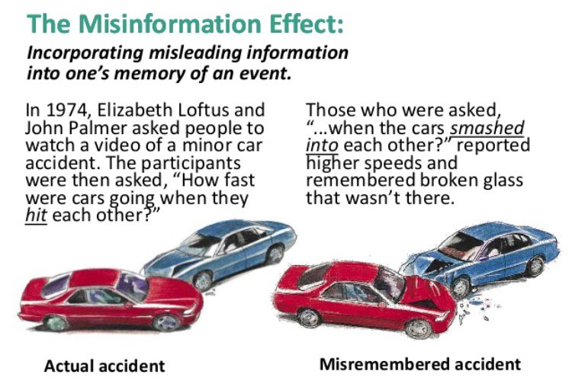
The History of Memory Research
(8 of 8)
Elizabeth Loftus (1944–)
Misinformation effect.
False memories of normal people.
Notes:
Satisfies Learning Objective 2: Describe the history of memory research.
Work on the misinformation effect: It brought memory science into a number of applied domains, particularly into the courtroom and other legal settings.
False memories of normal people:
She showed that subtly introduced misinformation given after an event had been witnessed influenced people’s memory of that witnessed event.
She also testified in many trials, claiming that eyewitness memory may be error, thereby bringing empirical memory science into the legal systems of many nations.
She became a leading proponent of the idea that memory is fallible in general, and that normal people have false memories.
This idea greatly impacted some forms of psychotherapy, which were based on the recovery of hidden memories.

Slide 19
Methods of Studying Memory (1 of 9)
Experiment: Observations under controlled circumstances.
Independent variables: Manipulated factors.
Dependent variables: Depends on independent variable.
Notes:
To study memory objectively, to make statements or generalizations about how memory works in human beings, and to get reasonable estimates of measurable individual differences, we must apply the scientific method.
Experiment: Set of observations that occur under controlled circumstances determined by the experimenter.
Controlled circumstances mean that the researcher strives to maintain a situation in which he or she has control over what a participant sees, hears, or can potentially remember. This helps to focus on one select issue at a time.
Independent variables: Independent variables are the factors that the experimenter manipulates across different conditions.
For example, if an experimenter wishes to know whether coffee containing caffeine can improve memory, he or she can manipulate the amount of coffee given to individuals in different groups of participants. In this example, the amount of coffee consumed is the independent variable.
Dependent variables: Dependent variables are the observations that we measure or record in response to the independent variable.
For example, in the coffee experiment, the dependent variable is the number of words the participants recall from the study list.
Random assignment

Slide 20
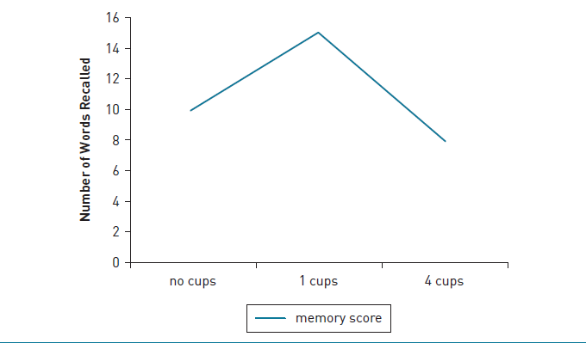
Methods of Studying Memory (2 of 9)
Notes:
Satisfies Learning Objective 3: Evaluate memory methodology and how it addresses issues of human memory.
Figure 1.4: Graph of memory as a function of caffeine consumed. This graph shows a potential hypothetical outcome. A small amount of caffeine boosts memory, but a larger amount hurts memory. In fact, research shows that caffeine can hurt memory even at relatively small amounts. The y-axis is the number of words recalled.

Slide 21
Memory Measures (3 of 9)
Recall
Generate target memory based on cues.
Free recall: Global cue to remember memory.
Cued recall: Specific cue to remember specific memory.
Notes:
Satisfies Learning Objective 3: Evaluate memory methodology and how it addresses issues of human memory.
Recall: A person must generate the target memory based on cues, without seeing or hearing the actual target memory.
For example, when someone tells you about their dinner at a restaurant the previous night they are recalling the event.
Free recall: A person must generate memories with minimal or no cuing of the memories.
All the information recalled is freely selected by the rememberer.
In memory experiments, free recall is more likely to be “Write down all the words from the study list.”
Cued recall: A person is given a specific cue and must generate a target memory that corresponds to that cue.
For example, in a cued recall test, you might receive the English word (walnut) and be asked to recall the French word.

Slide 22
Memory Measures (4 of 9)
Recognition
Identify target memory from a set.
Old/new recognition: Whether item was on list.
Forced-choice recognition: Multiple-choice recognition.
Recall vs recognition?
Notes:
Satisfies Learning Objective 3: Evaluate memory methodology and how it addresses issues of human memory.
Recognition: Person must identify the target memory from among a set of presented item(s).
For example, a person must match what is stored in memory with what he or she sees on a list.
Old/new recognition: Person must decide whether an item was on the study list.
For example, if participants saw the word pasture on the study list, they would need to indicate that by saying “old,” whereas if the participants had not seen the word, they would indicate that by saying “new.”
Forced-choice recognition: Person must identify the answer from among a series of possible answers.
For example, using the earlier examples, we could ask a recognition question such as “In what year was Aristotle born? (a) 502 CE, (b) 5 CE, (c) 384 BCE, (d) 672 BCE.” (The correct answer is 384 BCE.)
Key difference between recall and recognition: In recall, the person must generate the memory, whereas in recognition, the person must match what is in his or her memory with what he or she sees in front of them.

Slide 23
Memory Measures (5 of 9)
Reaction Time
Amount of time to perform a task.
Variation in reaction time.
Study on reaction times of old/new recognition judgments.
Notes:
Satisfies Learning Objective 3: Evaluate memory methodology and how it addresses issues of human memory.
Reaction time: The measured amount of time required to perform a particular task.
Variation: Reaction time varies as a function of the number or difficulty of the underlying memory processes.
Longer reaction times usually reflect more internal cognitive processing.
Dewhurst and Conway looked at reaction times of old/new recognition judgments: If people felt as though they “remembered” the items from the earlier list, they had faster reaction times than if they felt as though they “knew” the items were from the earlier list.

Slide 24
Memory Measures (6 of 9)
Source Judgments
Attribution of source of learning
Reality monitoring: Distinguish between real and imagined event.
Notes:
Satisfies Learning Objective 3: Evaluate memory methodology and how it addresses issues of human memory.
Source judgments: Our attributions of where or from whom we learned something.
For example, a student may recall that it was the teaching assistant and not the professor who told her that a particular chapter would be on the exam.
In gossip, the source of memory is important. If you read a story on a tabloid newspaper, it may be of dubious validity. However, if you saw it on CNN, it is more likely to be true.
Reality monitoring: Our ability to distinguish whether our memory is of a real or an imagined event.
Recently, there has been work on whether we can identify whether other peoples’ memories are real or imagined.

Slide 25
Memory Measures (7 of 9)
Metamemory Judgments
Metamemory: Self-awareness of memory processes.
Judgments of learning (JOL): Predicting likelihood of later remembrance.
Notes:
Satisfies Learning Objective 3: Evaluate memory methodology and how it addresses issues of human memory.
Metamemory: Our knowledge and awareness of our own memory processes.
Judgments of learning: Predictions we make as we study items of the likelihood that we will remember them later.

Slide 26
Memory Measures (8 of 9)
Neuroimaging
Techniques to visually examine brains.
Help correlate cognition and behavior with brain function.
Used to investigate memory, perception, language, and emotion.
Notes:
Satisfies Learning Objective 3: Evaluate memory methodology and how it addresses issues of human memory.
Neuroimaging: Refers to a set of techniques that allows researchers to make detailed maps of the human brain and assign functions to particular regions in the brain.
Neuroimaging techniques allow scientists to correlate cognition and behavior with function in normal, active brains: Neuroimaging techniques allow us to trace the flow of information in the brain as individual people think.

Slide 27
Memory Measures (9 of 9)
Neuroimaging
Determine where a brain process occurs
Sequential changes in brain activity
Many devices/methods!
  fMRI
  EEG
  PET Scans
Notes:
Satisfies Learning Objective 3: Evaluate memory methodology and how it addresses issues of human memory.
Goals of neuroimaging: To determine where things happen in the brain and how they unfold over time.
To determine where in the brain a particular process is occurring, scientists can use neuroimaging to develop detailed spatial maps of the brain showing which areas are active during which cognitive task.
To determine the flow of activity in the brain over time, scientists can use neuroimaging to take pictures of the brain in quick succession to determine the time course of processes.
EEG (electroencephalography): Using electrodes to measure the electrical output of the brain by recording electric current at the scalp.
EEG provides an excellent way of measuring the changes that happen in the brain as a person engages in a memory task.
Many cognitive tasks produce ERP(event-related potential)-identifiable patterns that mark a particular cognitive task.
MEG (magnetoencephalography): Using a magnetic sensor to detect the small magnetic fields produced by electrical activity in the brain.
MEG can produce better spatial maps of the brain than can EEG, though not as good as fMRI.
MEG is useful today because it represents a compromise between good spatial resolution and good temporal resolution.
PET (positron emission tomography): Radioactive chemicals are placed in the blood, allowing scientists to obtain a three-dimensional image of the intact brain.
PET is very good at making spatial maps of the brain and pinpointing where in the brain activity is taking place. However, successive images can be made only every 30 seconds, so it is not helpful in determining the flow of information in the brain.

